Slide 1
Computer Organization & Design 实验与课程设计
Computer Organization & Design
Lab 10
Datapath for multicycle CPU design
施青松
Asso. Prof. Shi Qingsong
College of Computer Science and Technology, Zhejiang University
zjsqs@zju.edu.cn

Slide 2
Course Outline
Environment
Task
Principles
Implementation
Notes:
Rudimentary logic functions=基本的逻辑函数

Slide 3
Course Outline
Environment
Task
Principles
Implementation
Notes:
Rudimentary logic functions=基本的逻辑函数

Slide 4
Task
1. Build datapath for multicycle CPU to implement 9+ instructions
build datapath using schematic way
R-Type：add，sub，and，or，slt，nor*；
I-Type： lw，sw，beq；
J-Type： J
Use HDL to implement datapath
Use modules of lab4 for ALU and Regs
Substitute datapath core of lab9
2. Datapath testing
Design test scenario and test program
Test datapath for ：I-format、R-format

Slide 5
Course Outline
Environment
Task
Principal
Implementation

Slide 6
CPU organization
Digital circuit
General circuits that controls logical event with logical gates --Hardware
Computer organization
Special circuits that processes logical action with instructions -Software
Data input
Control unit
Control signals
Datapath
Data output
Status input
Status signals
Control output

Slide 7
Datapath for multicycle implementation：is extensible and compatible for 9-23⁺ instructions by more choices through mux
Find dapath for instructions：5+1个MUX
What paths are added comparing with single-cycle implementation?

Slide 8
Control signals：Defined 10+6+？control
Modify the table of single-cycle implementation
信号 | 源数目 | 功能定义 | Operation when Assign 0 | Operation when assign 1
ALUScrA ALUSrc_B | ？ | ALU端口A、B输入选择
RegDst | ？ | 寄存器写地址选择(考虑扩展)
MemtoReg | ？ | 寄存器写数据选择(考虑扩展)
IorD | ？ | 新增
PCSource | ？ | 新增
PCWriteCond | ？ | 新增
…… | ？ | 新增
Branch | ？ | Beq指示(考虑Bne扩展)
RegWrite | - | 寄存器写控制
MemWrite | - | 存储器写控制
MemRead | - | 存储器读控制
ALU_Control | 000- 111 | 3位ALU操作控制 | 参考表 Exp04 | Exp04
Fill in the corresponding operation for each assignment

Slide 9
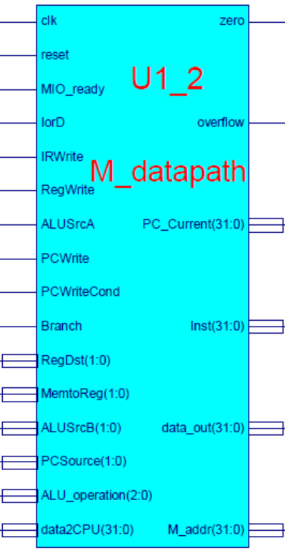
Datapath module： M_datapath
datapath
Main unit of CPU
Register transfer object：general datapath
Basic function
ALU with computing function
General purpose registers
All possible paths with counting function
Key signals
Inst_R：Instruction register output
PC_Current：current PC(PC+4)
M_addr：memory address
Branch：=1→beq；=0 → bne
PCWriteCond：for Branch instruction

Slide 10
Interface file- M_datapath.v
module M_datapath(input clk,
input reset,
input MIO_ready, //外部输入=1
input IorD,
input IRWrite,
input[1:0] RegDst, //预留到2位
input RegWrite,
input[1:0]MemtoReg, //预留到2位
input ALUSrcA,
input[1:0]ALUSrcB,
input[1:0]PCSource, //4选1控制
input PCWrite,
input PCWriteCond,
input Branch,
input[2:0]ALU_operation,
output[31:0]PC_Current,
input[31:0]data2CPU,
output[31:0]Inst,
output[31:0]data_out,
output[31:0]M_addr,
output zero,
output overflow
);
endmodule

Slide 11
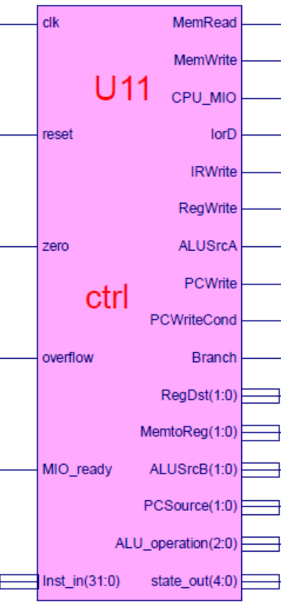
CPU unit 2 -controller：ctrl
This lab use IP soft core- ctrl
Called module: ctrl.ngc
Interface file (empty file)：ctrl.v
Symbol file：ctrl.sym
Key signals
MIO_ready：for I/O ready
=0 CPU wait
=1 CPU run
Always 1 for this lab
Inst_in：instruction input，comingfrom IR
State_out：state code，for test

Slide 12
Interface file- ctrl.v
module ctrl(input clk,
input reset,
input [31:0] Inst_in,
input zero,
input overflow,
input MIO_ready, //外部输入=1
output reg MemRead,
output reg MemWrite,
output reg[2:0]ALU_operation, //ALU_Control
output [4:0]state_out,
output reg CPU_MIO,
output reg IorD,
output reg IRWrite,
output reg [1:0]RegDst, //预留到2位
output reg RegWrite,
output reg [1:0]MemtoReg, //预留到2位
output reg ALUSrcA,
output reg [1:0]ALUSrcB,
output reg [1:0]PCSource,
output reg PCWrite,
output reg PCWriteCond,
output reg Branch
);
endmodule

Slide 13
U3-memory initialization file： mem.coe contains both code and data
memory_initialization_radix=16;
memory_initialization_vector=
00A52820, AC650000, 8C650000, 00A85824, 01A26820, 11A00017, 8C650000, 01CE9020, 0252B020, 02569020, 00B25824, 11600005, 1172000A, 01CE9020, 1172000B, AC890000, 08000036, 11410001, 0800004D, 00005027, 014A5020, AC8A0000, 08000036, 8E290860, AC890000, 08000036, 8E290820, AC890000, 08000036, 8C0D0014, 014A5020, 01425025, 022E8820, 02348824, 01224820, 11210001, 0800005F, 000E4820, 01224820, 8C650000,
00A55820, 016B5820, AC6B0000, AC660004, 0800003E, 00000000, 00000000, 00000000, 00000000, 00000000, 00000000, 00000000, 00000000, 00000000, 00000000, 00000000, 00000000, 00000000, 00000000, 00000000, 00000000, 00000000, 00000000, 00000000, 00000000, 00000000, 00000000, 00000000, 00000000, 00000000, 00000000, 00000000， ………………
………………
F0000000, 000002AB, 80000000, 0000003F, 00000001, FFFF0000, 0000FFFF, 80000000, 00000000, 11111111, 22222222, 33333333, 44444444, 55555555, 66666666, 77777777, 88888888, 99999999, AAAAAAAA, BBBBBBBB, CCCCCCCC, DDDDDDDD, EEEEEEEE, FFFFFFFF, 557EF7E0, D7BDFBD9, D7DBFDB9, DFCFFCFB, DFCFBFFF, F7F3DFFF, FFFFDF3D, FFFF9DB9, FFFFBCFB, DFCFFCFB, DFCFBFFF, D7DB9FFF, D7DBFDB9, D7BDFBD9, FFFF07E0, 007E0FFF,
03BDF020, 03DEF820, 08002300, 00000000, 00000000, 00000000, 00000000, 00000000;
9条指令设计的，根据实验三修改
Code section：address start at 00000000
Data section：start address should be defined：here is 00000200

Slide 14
Course Outline
Environment
Task
Principle
Implementation

Slide 15
CPU datapath design
-implement in HDL
-call multiplexers of lab1
-call arithmetic functions of lab1
-call ALU and Regs of lab4

Slide 16
Project：OExp10-MDP
Design CPU datapath
Design datapath for 9⁺ instructions
Simulation for M_Datapath.v module
Substitute given core by your own module
Substitute M_Datapath.ngc of Exp09
Top module of Exp09 doesn’t change
name：Top_OExp09_MDP.v
Test datapath module
Design test program (MIPS assembling program) to test：
ALU function
I-format instructions
R-format instructions

Slide 17
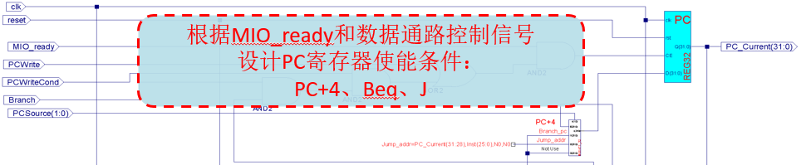
Design Gist
Creat DataPath HDL input template
Design PC path
Call REG32 and MUX4T1_32 modules
For your reference
assign CE = MIO_ready ?? (PCWrite || (PCWriteCond && zero&&Branch));
MUX4T1_32 MUX6(.I0(PC+4?), .I1(Beq?), .I2(Jump?), .I3(No Use), .o(PC_next));
REG32 PC(.clk(???), .rst(???), .CE(CE), .D(PC_next), .Q(PC_Current));
……

Slide 18
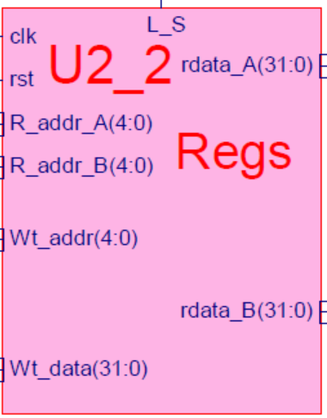
Variable transmission and call Regs of Exp04
wire[4:0] reg_Rs_addr_A = Inst_R[25:21]; //REG Source 1 rs
wire[4:0] reg_Rt_addr_B = Inst_R[20:16]; //REG Source 2 or Destination rt
wire[4:0] reg_rd_addr = Inst_R[15:11]; //REG Destination rd
wire[15:0] imm = Inst_R[15:0]; //Immediate
wire[25:0] direct_addr = Inst_R[25:0]; //Jump addre
Regs regs(.clk(clk),
.rst(rst),
.R_addr_A(reg_Rs_addr_A),
.R_addr_B(reg_Rt_addr_B),
.Wt_addr(?????????), //来自MUX1输出
.Wt_data(?????????), //来自MUX2输出
.L_S(RegWrite), //来自控制器
.rdata_A(rdata_A), //送MUX4
.rdata_B(rdata_B) //送MUX3
);
assign data_out=rdata_B;

Slide 19
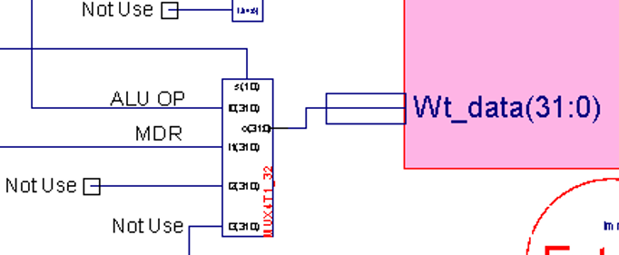
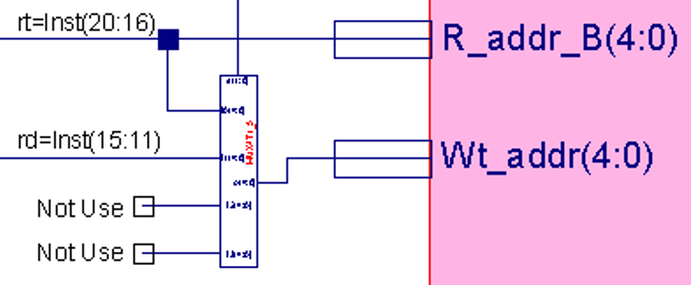
Regs path
// reg write data port
MUX4T1_32 MUX2(.I0(ALU_Out), //ALU OP
.I1(MDR), //LW
.I2({32'h00000000}), // not use
.I3(32'h00000000), // not use
.s(MemtoReg),
.o(w_reg_data)
);
// reg write addr port
MUX4T1_5 MUX1(.I0(reg_Rt_addr_B), //reg addr=IR[21:16]
.I1(reg_rd_addr), //reg addr=IR[15:11], LW or lui
.I2(5'b11111), // not use
.I3(5'b00000), // not use
.s(RegDst),
.o(reg_Wt_addr)
);

Slide 20
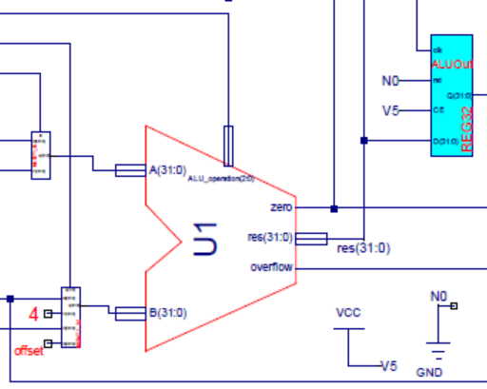
Call ALU of Exp04
ALU path and ALU calls
alu x_ALU(.A(Alu_A),
.B(Alu_B),
.ALU_operation(ALU_operation),
.res(res),
.zero(zero),
.overflow(overflow)
);
MUX2T1_32 MUX4 (.I0(rdata_A), // reg out A
.I1(PC_Current), // PC
.s(ALUSrcA),
.o(Alu_A)
);
MUX4T1_32 MUX3(.I0(rdata_B), //reg out B
.I1(PC+4?), //4 for PC+4
.I2(???????), //可扩展imm
.I3(???????), //可扩展offset
.s(ALUSrcB),
.o(Alu_B)
);
REG32 ALUOut(.clk(???), .rst(???), .CE(???), .D(res), .Q(ALU_Out) );

Slide 21
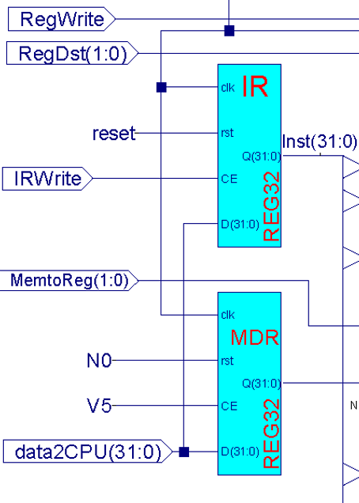
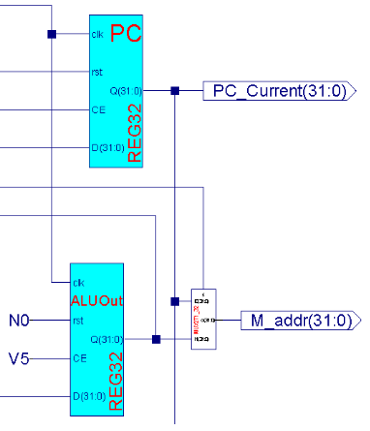
Instruction register and MDR
REG32 IR(.clk(???), .rst(???), .CE(???), .D(???), .Q(Inst) );
REG32 MDR(.clk(???), .rst(???), .CE(???), .D(???), .Q(MDR) );
MUX2T1_32 MUX5 (.I0(ALU_Out), //access memory
.I1(PC_Current), //IF
.s(IorD),
.o(M_addr)
);

Slide 22
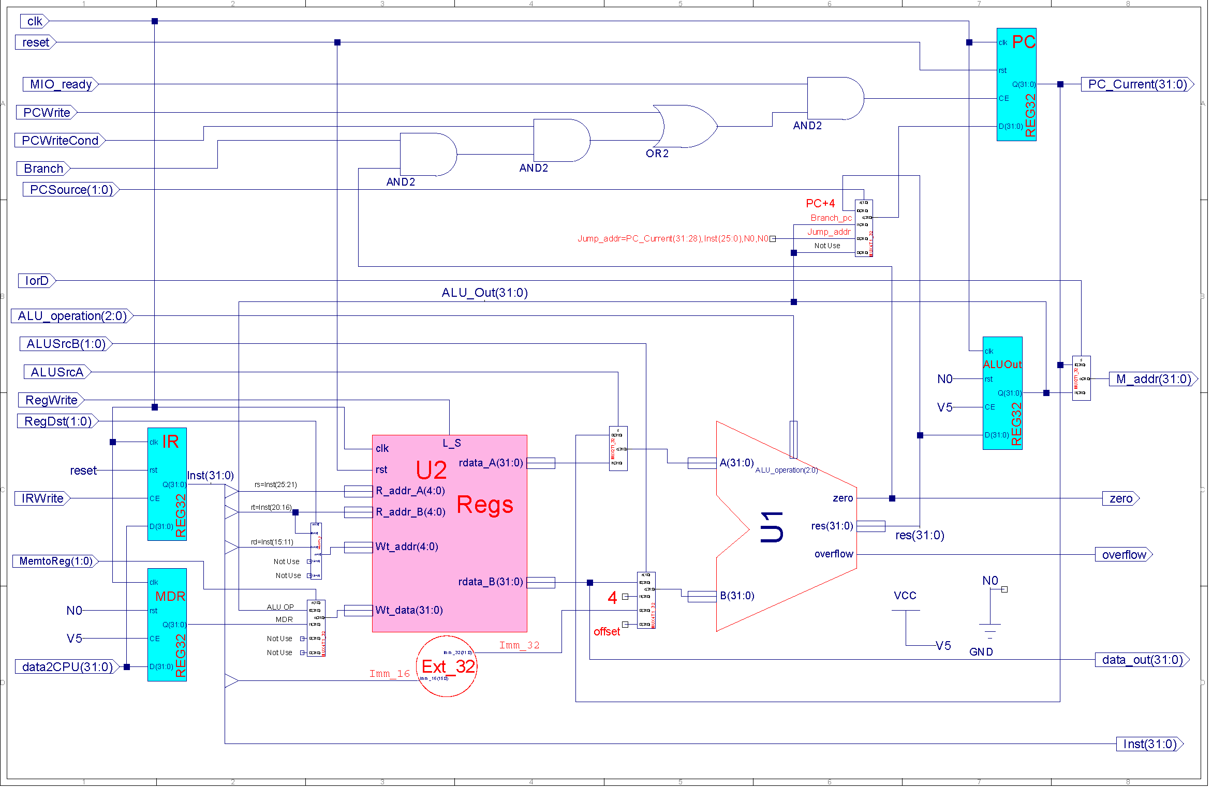
Complete datapath for reference
根据MIO_ready和数据通路控制信号
设计PC寄存器使能条件：
PC+4、Beq、J

Slide 23
Datapath simulation
Refer to exp05，pay attention to timing of multicycle
M_Datapath module simulation
Simulation after syntax checking (no Errors和warnings)
Simulation code keypoints
Only functional test，no performance test
Datapath function test
Choose instructions to cover all datapaths
input：
compute all control signals, data value and timing for each instruction
clk、rst
ALU function test
Choose add、and、sub、or、nor、slt instruction
compute all control signals and data value for each instruction
Choose compare for Beq、address computing for Load和Store
Regs function test
Use Add instruction to traverse each register

Slide 24
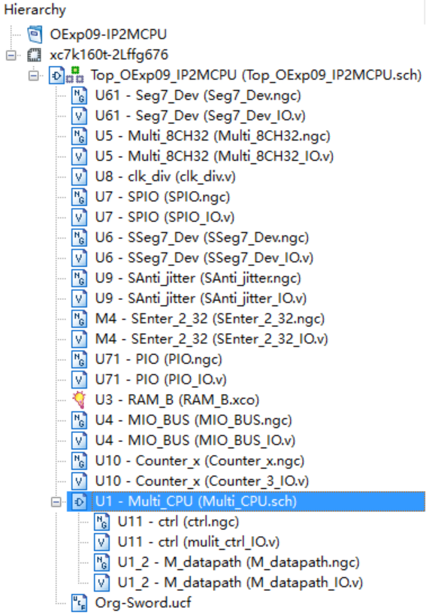
M_Datapath substitution
substitution
Substitute datapath IP core after correct simulation
Cleanup Exp09 project
Remove datapath core from the project
Delete datapath core file from the project
Delete M_Datapath.ngc and replace by M_Datapath.v
In Project menu, run： Cleanup Project Files …
Suggest to rebuild project using the resourses of Exp09
Except M_Datapath.ngc
Should be removed

Slide 25
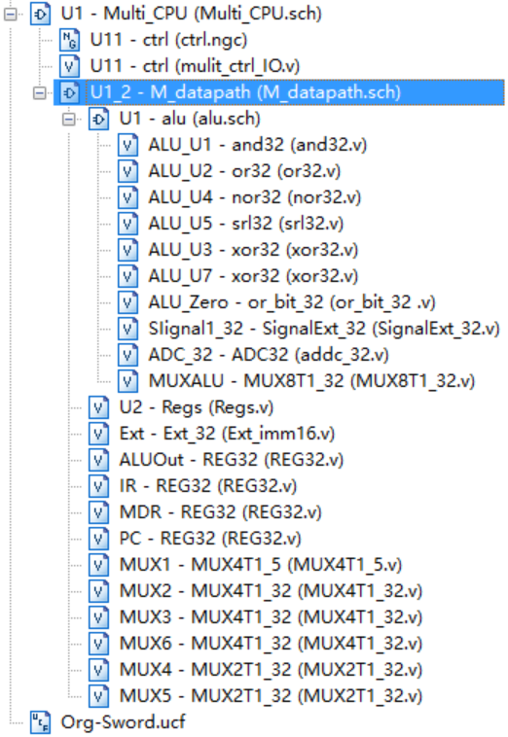
Structure after DataPath core substitution
Controller still uses IP core
Module calls after Exp10 is finished
Registers for：
instruction、PC、memory address and ALU output
6 mux：
MUX1,2：Regs input；MUX6：PC；MUX5：memory address; MUX3,4：ALU input

Slide 26
Physical verification
Use DEMO to test datapath function
DEMO interface
SW[7:5]=000， SW[2]=0(run without stop)
SW[4:3]=00， SW[0]=0，点阵显示程序：跑马灯
SW[4:3]=00， SW[0]=0，点阵显示程序：矩形变幻
SW[4:3]=01， SW[0]=1，内存数据显示程序：0～F
SW[4:3]=10， SW[0]=1，当前寄存器R9+1显示
Use assembling program to test
Test ALU function
Test Regs access
Test datapath for I-format instruction
Test datapath for R-format instruction

Slide 27
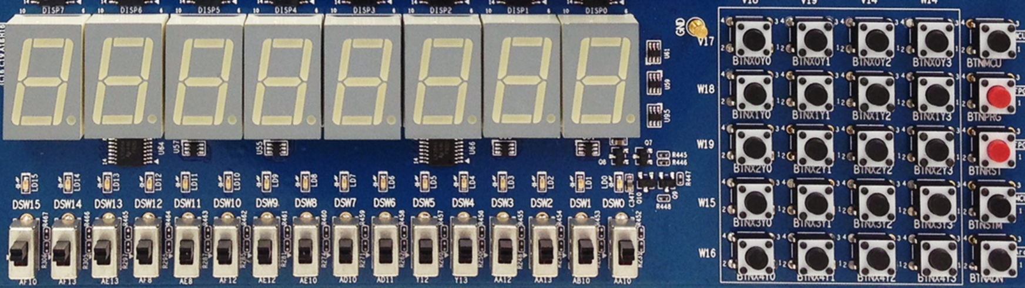
DEMO interface
X₀Y₀
X₀Y₁
X₀Y₂
X₀Y₃
MCU3
0
1
2
3
X₁Y₀
X₁Y₁
X₁Y₂
X₁Y₃
PRGO
SEG3
SEG2
SEG1
SEG0
SEG3
SEG2
SEG1
SEG0
4
5
6
7
X₂Y₀
X₂Y₁
X₂Y₂
X₂Y₃
RSTN
LED15 LED14 LED13 LED12 LED11 LED10 LED9 LED8 LED7 LED6 LED5 LED4 LED3 LED2 LED1 LED0
8
9
A
B
X₃Y₀
X₃Y₁
X₃Y₂
X₃Y₃
MCU1~2
C
D
E
F
W15 SW14 SW13 SW12 SW11 SW10 SW9 SW8 SW7 SW6 SW5 SW4 SW3 SW2 SW1 SW0
X₄Y₀
X₄Y₁
X₄Y₂
X₄Y₃
Ardunio
SW[7:5]=显示通道选择
SW[7:5]=000：CPU程序运行输出
SW[7:5]=001：测试PC字地址
SW[7:5]=010：测试指令字
SW[7:5]=011：测试计数器
SW[7:5]=100：测试RAM地址
SW[7:5]=101：测试CPU数据输出
SW[7:5]=110：测试CPU数据输入
SW[0]=文本图形选择
SW[1]=高低16位选择
没有使用
SW[2]=CPU单步时钟选择
DEMO功能，测试程序可以替换成自己的功能
SW[4:3]=00，点阵显示程序：跑马灯
SW[4:3]=00，点阵显示程序：矩形变幻
SW[4:3]=01，内存数据显示程序：0～F
SW[4:3]=10，当前寄存器+1显示

Slide 28
Test code reference：ALU和Regs
Design test code for ALU和Regs to replace DEMO
ALU、Regs test code ，test result is observed by CPU output step by step
SW[7:5]=100, Addr_out=ALU output
SW[7:5]=101，Data_out=outout of register B
#baseAddr 0000
loop: nor r1,r0,r0; //r1=FFFFFFFF
slt r2,r0,r1; //r2=00000001
add r3,r2,r2; //r3=00000002
add r4,r3,r2; //r4=00000003
add r5,r4,r3; //r5=00000005
add r6,r5,r4; //r6=00000008
add r7,r6,r5; //r7=0000000d
add r8,r7,r6; //r8=00000015
add r9,r8,r7; //r9=00000022
add r10,r9,r8; //r10=00000037
add r11,r10,r9; //r11=00000059
add r12,r11,r10; //r12=00000090
add r13,r12,r11; //r13=000000E9
add r14,r13,r12; //r14=00000179
add r15,r14,r13; //r15=00000262
add r16,r15,r14; //r16=000003DB
add r17,r16,r15; //r17=000006D3
add r18,r17,r16; //r18=00000A18
add r19,r18,r17; //r19=000010EB
add r20,r19,r18; //r20=00001B03
add r21,r20,r19; //r21=00003bEE
add r22,r21,r20; //r22=000046F1
add r23,r22,r21; //r23=000080DF
add r24,r23,r22; //r24=0000C9D0
add r25,r24,r23; //r25=00014AAF
add r26,r25,r24; //r26=0001947F
add r27,r26,r25; //r27=0012DF2E
add r28,r27,r26; //r28=001473AD
add r29,r28,r27; //r29=002752DB
add r30,r29,r28; //r30=003BC688
add r31,r30,r29; //r31=00621963
j loop;

Slide 29
Test code reference
Design datapath test program to replace DEMO program
Datapath test reference。Result is observed through CPU output step by step
Datapath function is indicated by data transfer result, e.g., immediate datapath：observe 14+$zero
#baseAddr 0000
start: //通道结果由后一条指令读操作数观察
lw r5, 14($zero); //取测试常数55555555。存储器读通道
start_A:
add r1, r5, $zero; //r1: 寄存器写通道。R5:寄存器读通道A输出
nor r2, $zero, r1; //r1: 寄存器读通道B输出。R2:ALU输出通道
lw r5, 48($zero); //取测试常数AAAAAAAA。立即数通道:00000048
beq r2, r5 start_A; //loop test
j start; //loop test。Immediate datapath：00000014
Completeness of test
Correct result of the above test can only demonstrate the correctness of bus transfer and path exchange. For the completeness of test, each possible case should be covered.

Slide 30
Memory test
Design memory test program
Address of 7-seg display is E0000000/FFFFFFE0
LED display address is F0000000/FFFFFF00
Design memory test program
Result is indicated on 7-seg display
RAM initialization data：refer to DEMO design of single-cycle
memory_initialization_radix=16;
memory_initialization_vector=
00A52820, AC650000, 8C650000, 00A85824, 01A26820, 11A00017, 8C650000, 01CE9020, 0252B020, 02569020, 00B25824, 11600005, 1172000A, 01CE9020, 1172000B, AC890000, 08000036, 11410001, 0800004D, 00005027, 014A5020, AC8A0000, 08000036, 8E290860, AC890000, 08000036, 8E290820, AC890000, 08000036, 8C0D0014, 014A5020, 01425025, 022E8820, 02348824, 01224820, 11210001, 0800005F, 000E4820, 01224820, 8C650000, 00A55820, 016B5820, AC6B0000, AC660004, 0800003E, …………………………………………
F0000000, 000002AB, 80000000, 0000003F, 00000001, FFF70000, 0000FFFF, 80000000, 00000000, 11111111, 22222222, 33333333, 44444444, 55555555, 66666666, 77777777, 88888888, 99999999, aaaaaaaa, bbbbbbbb, cccccccc, dddddddd, eeeeeeee, FFFFFFFF, 557EF7E0, D7BDFBD9, D7DBFDB9, DFCFFCFB, DFCFBFFF, F7F3DFFF, FFFFDF3D, FFFF9DB9, FFFFBCFB, DFCFFCFB, DFCFBFFF, D7DB9FFF, D7DBFDB9, D7BDFBD9, FFFF07E0, 007E0FFF, 03bdf020, 03def820, 08002300;
Code section
Data section

Slide 31
Design test record form
Learn data statistics
Refer to college physical experiment course
This is no accurate computing in this experiment, but there are a great number of data forms.
Record ALU和Regs test result
Design your own data form
Record datapath test result
Design your own data form
Record data memory test result
Design your own data form

Slide 32
Thinking
Why a temporary register is required for ALU output to hold data？
Is there a conflict for ALU to compute memory address and normal arithmetic operation？
Whether datapath of this lab should be modified if we want to add I-Type arithmetic instruction？
Instruction extension，how to modify datapath：
R-Type： srl*, jr, jalr, eret*；
I-Type： addi, andi, ori, xori, lui, bne, slti
J-Type： Jal；

Slide 33
END

